Slide 1
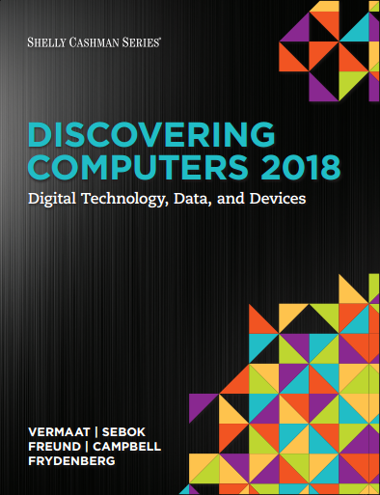

DISCOVERING COMPUTERS 2018 Digital Technology, Data, and Devices
Module 10
Communicating Digital Content:
Wired and Wireless Networks and Devices
Copyright © 2018 Cengage Learning®. May not be scanned, copied or duplicated, or posted to a publicly accessible website, in whole or in part.

Slide 2
Objectives Overview (1 of 2)
Discuss the purpose of the components required for successful communications and identify various sending and receiving devices
Differentiate among LANs, MANs, WANs, and PANs
Differentiate between client/server and peer-to-peer networks
Explain the purpose of communications software
Describe the various network communications standards and protocols

Slide 3
Objectives Overview (2 of 2)
Describe various types of communications lines
Describe commonly used communications devices
Discuss different ways to set up and configure a home network
Differentiate among physical transmission media
Differentiate among wireless transmission media

Slide 4
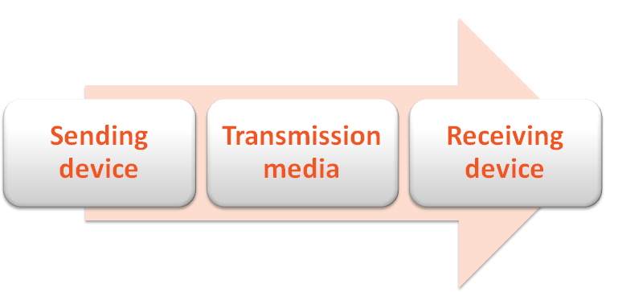
Communications (1 of 2)
Digital communications describes a process in which two or more computers or devices transfer data, instructions, and information

Slide 5
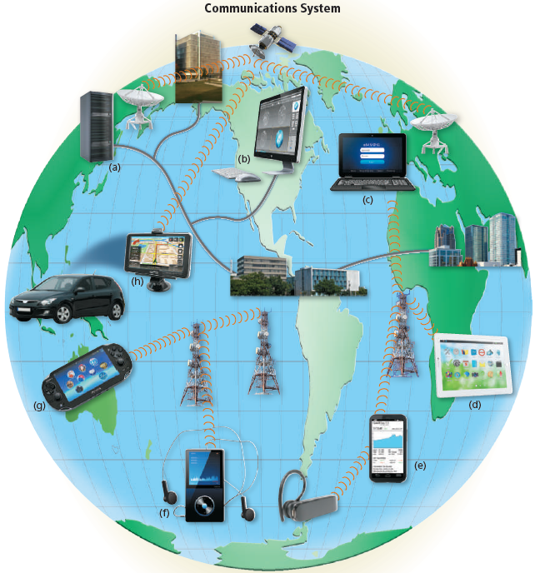
Communications (2 of 2)
Figure 10-1 A simplified example of a communications system. Some devices that serve as sending and receiving devices are (a) servers, (b) desktops, (c) laptops, (d) tablets, (e) smartphones and headsets, (f) portable media players, (g) handheld game devices, and (h) GPS receivers in vehicles. Transmission media consist of phone and power lines, cable television and other underground lines, microwave stations, and satellites.

Slide 6
Networks (1 of 9)
A network is a collection of computers and devices connected together via communications devices and transmission media
Advantages of a network include:
Facilitating communications
Sharing hardware
Sharing data and information
Sharing software
Transferring funds

Slide 7
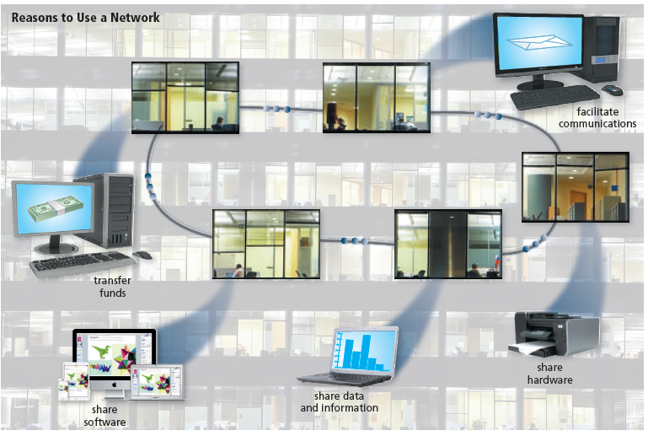
Networks (2 of 9)
Figure 10-2 Networks facilitate communications; enable sharing of hardware, data and information, and software; and provide a means for transferring funds.

Slide 8
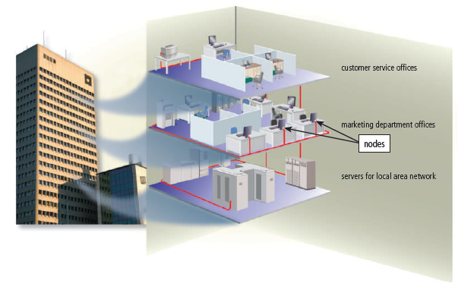
Networks (3 of 9)
A local area network (LAN) is a network that connects computers and devices in a limited geographical area
A wireless LAN (WLAN) is a LAN that uses no physical wires
Figure 10-3 Computers and devices on different floors access the same LAN in an office building. Computers and devices on the network often are identified as nodes. Xtuv Photography / Shutterstock.com

Slide 9
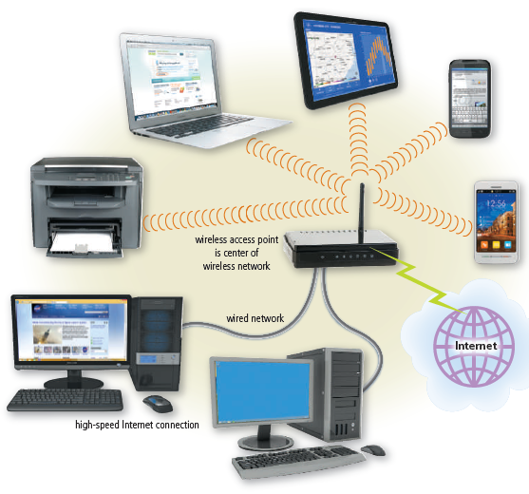
Networks (4 of 9)
Figure 10-4 Computers and mobile devices on a WLAN may communicate via a wireless access point with a wired LAN to access its hardware, software, Internet connection, and other resources.

Slide 10
Networks (5 of 9)
A metropolitan area network (MAN) connects LANs in a metropolitan area
A wide area network (WAN) is a network that covers a large geographic area
A personal area network (PAN) is a network that connects computers and devices in an individual’s workspace using wired and wireless technology

Slide 11
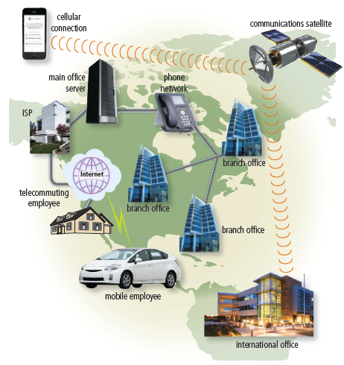
Networks (6 of 9)
Figure 10-5 A simplified example of a WAN.

Slide 12
Networks (7 of 9)
The configuration of computers, devices, and media on a network is sometimes called the network architecture

Slide 13
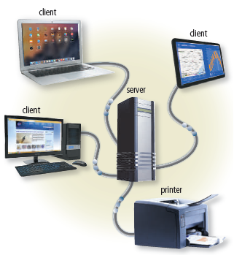
Networks (8 of 9)
Client/server network
Figure 10-6 As illustrated by the communications in this simplified diagram, on a client/server network, one or more computers act as a server, and the client computers and mobile devices access the server(s). Connections can be wired or wireless and may occur through a communications device.

Slide 14
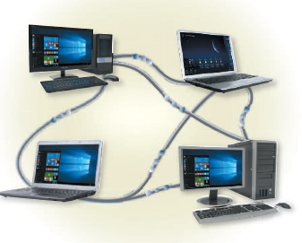
Networks (9 of 9)
Peer-to-peer network
Figure 10-7 As illustrated by the communications in this simplified diagram, each computer or mobile device on a P2P network shares its hardware and software with other computers and mobile devices on the network. Connections can be wired or wireless and may occur through a communications device.

Slide 15
Communications Software
Communications software consists of programs and apps that:
Help users establish a connection to another computer, mobile device, or network
Manage the transmission of data, instructions, and information
Provide an interface for users to communicate with one another

Slide 16
Network Communications Standards and Protocols (1 of 6)
Ethernet
Token ring
TCP/IP
Wi-Fi
LTE
Bluetooth
UWB
IrDA
RFID
NFC

Slide 17
Network Communications Standards and Protocols (2 of 6)
Ethernet is a network standard that specifies no central computer or device on the network (nodes) should control when data can be transmitted
The token ring standard specifies that computers and devices on the network share or pass a special signal (token)
TCP/IP is a network protocol that defines how messages (data) are routed from one end of a network to another

Slide 18
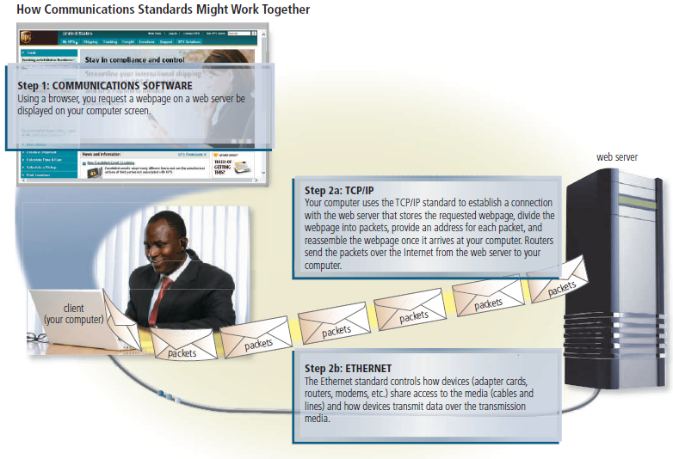
Network Communications Standards and Protocols (3 of 6)
Figure 10-8 This figure illustrates how Internet communications use TCP/IP and Ethernet to ensure that data travels correctly to its destination.

Slide 19
Network Communications Standards and Protocols (4 of 6)
Wi-Fi identifies any network based on the 802.11 standard that specifies how two wireless devices communicate over the air with each other
LTE is a network standard that defines how high-speed cellular transmissions use broadcast radio to transmit data for mobile communications
Bluetooth is a network protocol that defines how two Bluetooth devices use short-range radio waves to transmit data
UWB (ultra-wideband) is a network standard that specifies how two UWB devices use short-range radio waves to communicate at high speeds with each other
IrDA transmits data wirelessly via infrared (IR) light waves
RFID is a protocol that defines how a network uses radio signals to communicate with a tag placed in or attached to an object, an animal, or a person

Slide 20
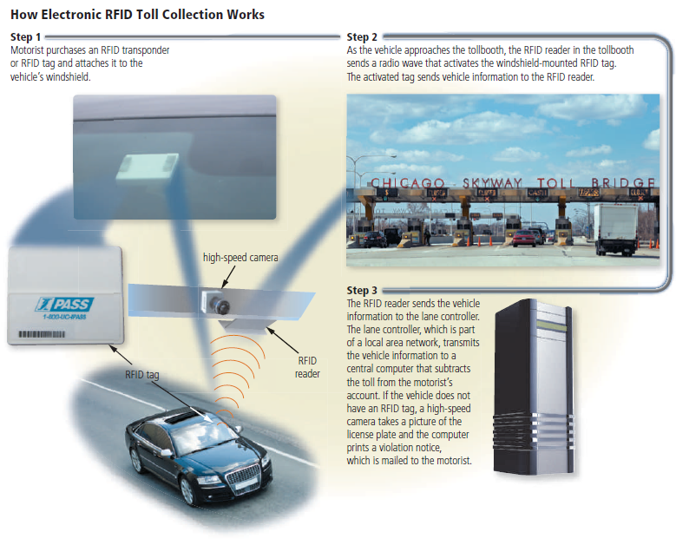
Network Communications Standards and Protocols (5 of 6)
Figure 10-9 This figure shows how electronic RFID toll collection works.

Slide 21
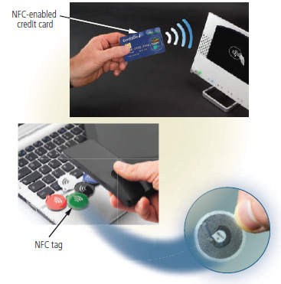
Network Communications Standards and Protocols (6 of 6)
NFC (near field communication) is a protocol, based on RFID, that defines how a network uses close-range radio signals to communicate between two devices or objects equipped with NFC technology
Figure 10-10 Some objects, such as credit cards, are NFC enabled. You also can program NFC tags yourself.

Slide 22
Communications Lines (1 of 2)
Table 10-2 Speeds of Various Dedicated Digital Lines
Type of Line | Transfer Rates
Cable television line | 256 Kbps to 100 Mbps or higher
DSL (Digital Subscriber Line) | 256 Kbps to 8.45 Mbps
FTTP (Fiber to the Premises) | 5 Mbps to 300 Mbps
Fractional T1 (for home and small business users) | 128 Kbps to 768 Kbps
T1 (for other business users) | 1.544 Mbps
T3 (for large corporations) | 44.736 Mbps
ATM (Asynchronous Transfer Mode) | 155 Mbps to 622 Mbps, can reach 10 Gbps
Fractional T1 lines, T1 lines, and T3 lines belong to the type of lines called T-Carrier lines.

Slide 23
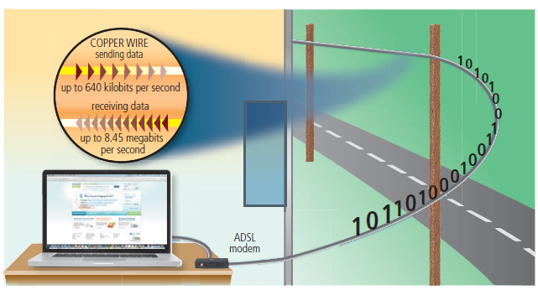
Communications Lines (2 of 2)
ADSL is a type of DSL that supports faster downstream rates than upstream rates
Figure 10-11 ADSL connections transmit data downstream (receiving) at a much faster rate than upstream (sending).

Slide 24
Communications Devices (1 of 10)
A communications device is any type of hardware capable of transmitting data, instructions, and information between a sending device and a receiving device
A broadband modem sends and receives data and information to and from a digital line
Cable modem
DSL modem

Slide 25
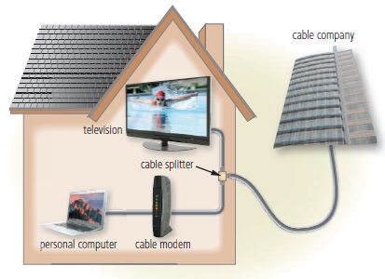
Communications Devices (2 of 10)
Figure 10-12 A typical cable modem installation.

Slide 26
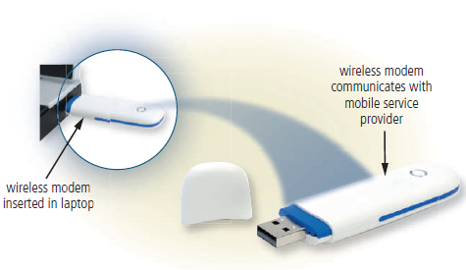
Communications Devices (3 of 10)
A wireless modem uses a mobile phone provider’s network to connect to the Internet wirelessly from a computer or mobile device
Figure 10-13 Wireless modems allow users to access the Internet wirelessly using a mobile service provider's network. Some manufacturers refer to the type of wireless modem shown in this figure as a USB modem.

Slide 27
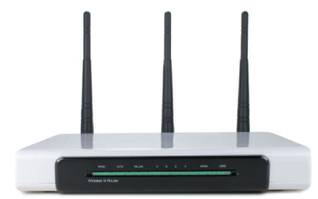
Communications Devices (4 of 10)
A wireless access point (WAP) is a central communications device that allows computers and devices to transfer data wirelessly among themselves or to a wired network
Figure 10-14 Wireless access point.

Slide 28
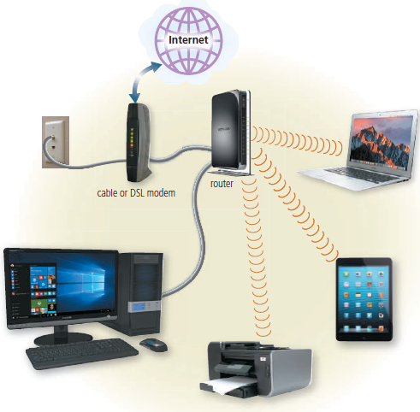
Communications Devices (5 of 10)
A router connects multiple computers or other routers together and transmits data to its correct destination on a network
Figure 10-15 Through a router, home and small business networks can share access to a broadband Internet connection, such as through a cable or DSL modem.

Slide 29
Communications Devices (6 of 10)
Some routers provide additional functionality:
Wireless router
Broadband router
Broadband wireless router
Mobile broadband wireless router

Slide 30
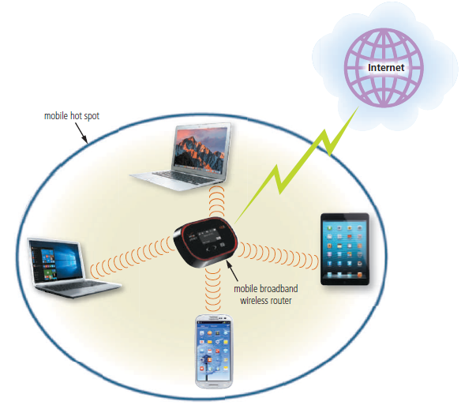
Communications Devices (7 of 10)
Figure 10-16 Through a mobile broadband wireless router, users can create a mobile hot spot via 3G or 4G mobile broadband Internet service.

Slide 31
Communications Devices (8 of 10)
A network card enables a computer or device that does not have built-in networking capability to access a network
Available in a variety of styles

Slide 32
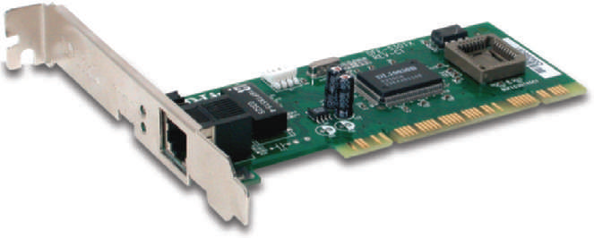
Communications Devices (9 of 10)
Figure 10-17 Network card for a desktop computer.

Slide 33
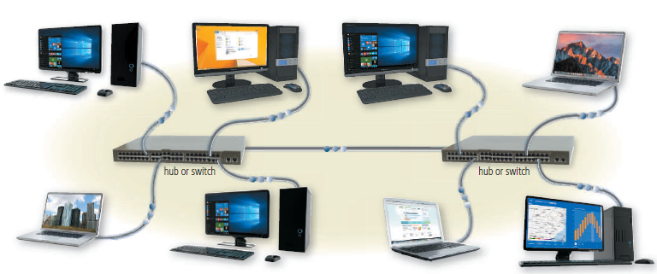
Communications Devices (10 of 10)
A hub or switch is a device that provides a central point for cables in a network
Figure 10-18 A hub or switch is a central point that connects several devices in a network together, as well as connects to other networks, as shown in this simplified diagram.

Slide 34
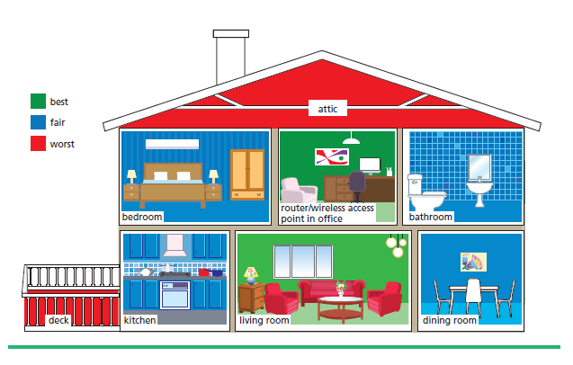
Home Networks
Many home users connect multiple computers and devices together in a home network

Slide 35
Transmission Media (1 of 2)
Transmission media carries one or more communications signals
Broadband media transmit multiple signals simultaneously
The amount of data, instructions, and information that can travel over transmission media sometimes is called the bandwidth
Latency is the time it takes a signal to travel from one location to another on a network

Slide 36
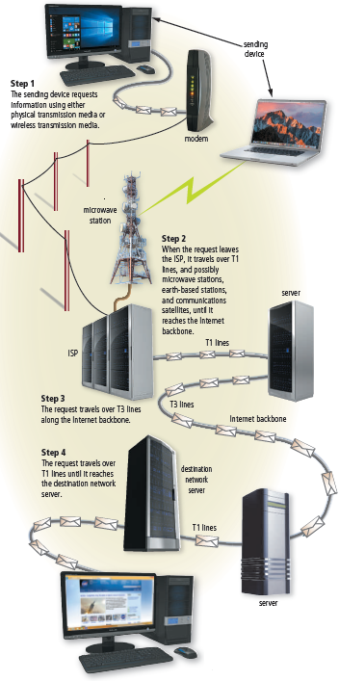
Transmission Media (2 of 2)
Figure 10-19 This figure shows a simplified example of sending a request over the Internet using a variety of transmission media.

Slide 37
Physical Transmission Media (1 of 4)
Table 10-3 Transfer Rates for Physical Transmission Media Used in LANs
Type of Cable and LAN | Maximum Transfer Rate
Twisted-Pair Cable
10Base-T (Ethernet) | 10 Mbps
100Base-T (Fast Ethernet) | 100 Mbps
1000Base-T (Gigabit Ethernet) | 1 Gbps
Token ring | 4 Mbps to 16 Mbps
Coaxial Cable
10Base2 (Thin Wire Ethernet) | 10 Mbps
10Base5 (Thick Wire Ethernet) | 10 Mbps
Fiber-Optic Cable
10Base-F (Ethernet) | 10 Mbps
100Base-FX (Fact Ethernet) | 100 Mbps
FDDI (Fiber Distributed Data Interface) token ring | 100 Mbps
Gigabit Ethernet | 1 Gbps
10-Giqabit Ethernet | 10 Gbps
40-Gigabit Ethernet | 40 Gbps
100-Gigabit Ethernet | 100 Gbps

Slide 38
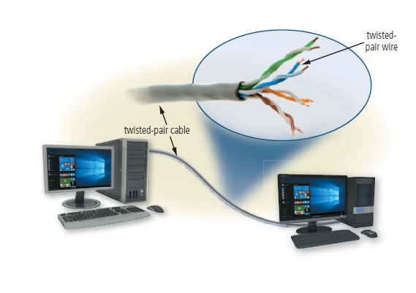
Physical Transmission Media (2 of 4)
Twisted-pair cable
Figure 10-20 A twisted-pair cable consists of one or more twisted-pair wires. Each twisted-pair wire usually is color coded for identification. Landline phone networks and LANs often use twisted- pair cable.

Slide 39
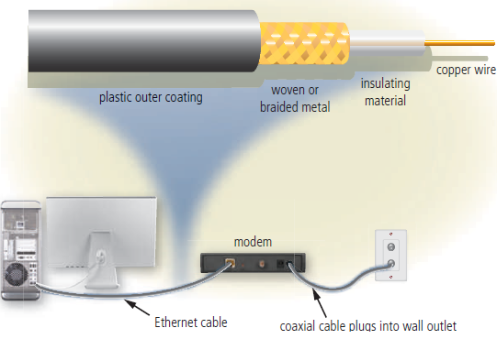
Physical Transmission Media (3 of 4)
Coaxial cable
Figure 10-21 On coaxial cables, data travels through a copper wire. This simplified illustration shows a computer connected to a modem, which also is connected to the CATV network through a coaxial cable.

Slide 40
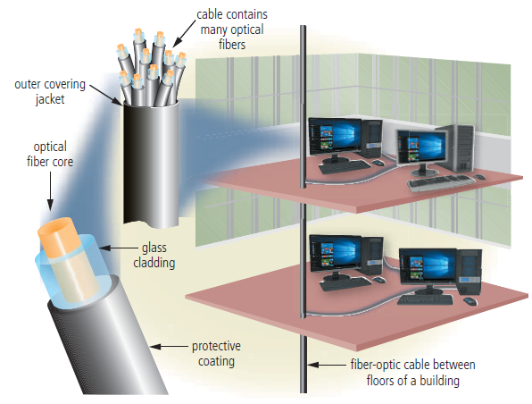
Physical Transmission Media (4 of 4)
Fiber-optic cable
Figure 10-22 A fiber-optic cable consists of hair-thin strands of glass or plastic that carry data as pulses of light, as shown in this simplified example.

Slide 41
Wireless Transmission Media (1 of 7)
Table 10-4 Wireless Transmission Media Transfer Rates
Medium |  | Maximum Transfer Transmission Rate
Infrared |  | 115 Kbps to 4 Mbps
Broadcast radio | Bluetooth | 1 Mbps to 24 Mbps
 | 802.11b | 11 Mbps
 | 802.11a | 54 Mbps
 | 802.11g | 54 Mbps
 | 802.11n | 300 Mbps
 | 802.11ac | 500 Mbps to 1 Gbps
 | 802.11ad | up to 7 Gbps
 | UWB (Ultra Wideband) | 110 Mbps to 480 Mbps
Cellular radio | 2G | 9.6 Kbps to 144 Kbps
 | 3G | 144 Kbps to 3.84 Mbps
 | 4G | Up to 100 Mbps
Microwave radio |  | Up to 10 Gbps
Communications satellite |  | Up to 2.56 Tbps

Slide 42
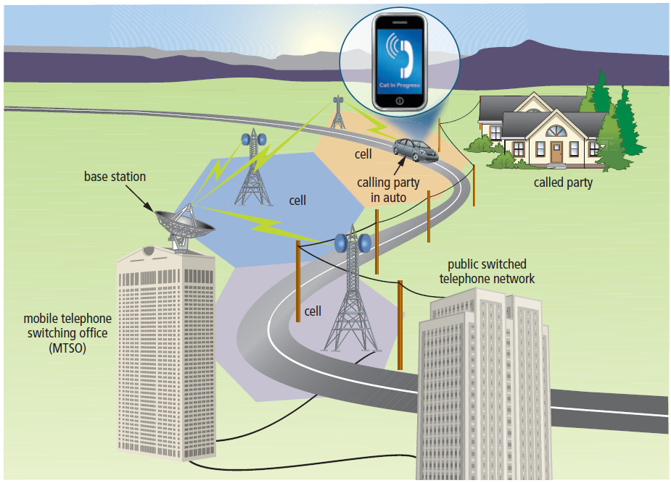
Wireless Transmission Media (2 of 7)
Broadcast radio is a wireless transmission medium that distributes radio signals through the air over long distances
Cellular radio is a form of broadcast radio that is in wide use for mobile communications
Figure 10-23 As a person with a mobile phone drives from one cell to another, the radio signals transfer from the base station (microwave station) in one cell to a base station in another cell.

Slide 43
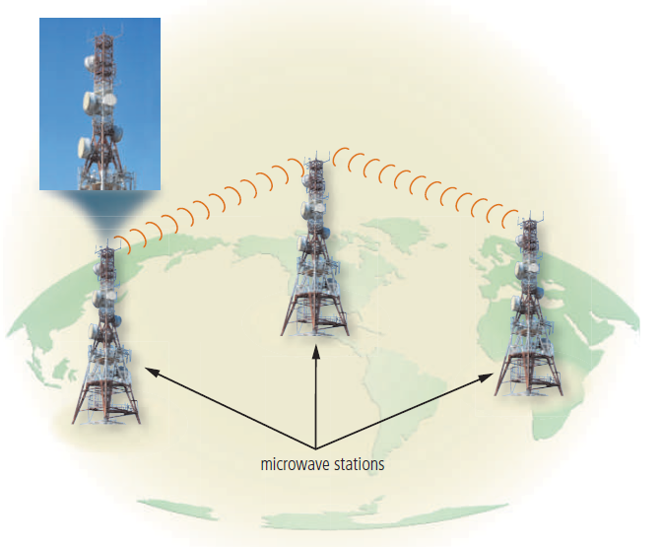
Wireless Transmission Media (3 of 7)
Microwaves are radio waves that provide a high-speed signal transmission
Figure 10-24 A microwave station is a ground-based reflective dish that contains the antenna, transceivers, and other equipment necessary for microwave communications.

Slide 44
Wireless Transmission Media (4 of 7)
A communications satellite is a space station that receives microwave signals from an earth-based station, amplifies it, and broadcasts the signal over a wide area to any number of earth-based stations

Slide 45
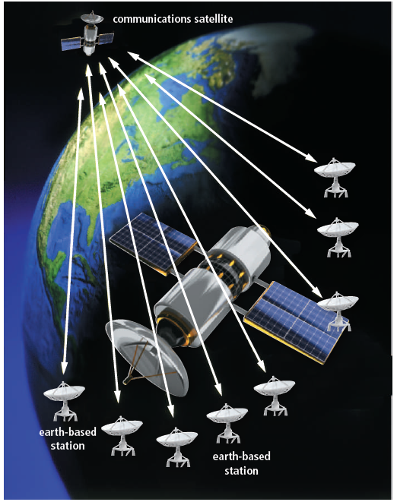
Wireless Transmission Media (5 of 7)
Figure 10-25 Communications satellites are placed about 22,300 miles above the Earth’s equator.

Slide 46
Wireless Transmission Media (6 of 7)
A GPS (global positioning system) is a navigation system that consists of one or more earth-based receivers that accept and analyze signals sent by satellites in order to determine the receiver’s geographical location

Slide 47
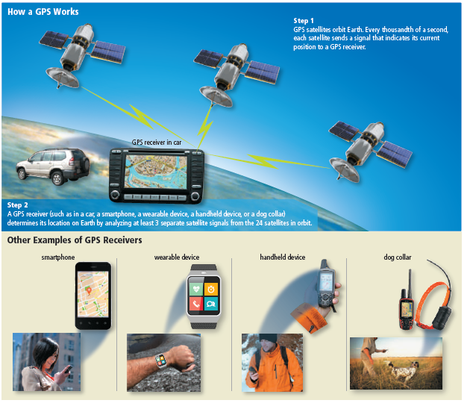
Wireless Transmission Media (7 of 7)
Figure 10-26 This simplified figure shows how a GPS works.

Slide 48
Summary
Networks and communications technologies
Various types of network architectures and standards and protocols
Communications software
Several types of communications lines and communications devices
How to create a home network
Variety of physical transmission media and wireless transmission media

